Slide 1

CSE214: Algorithms
Introduction to Greedy Approach
Knapsack and Huffman Coding
A I TAZIB
Lecturer, CSE
Department of CSE, DIU
‹#›
Notes:
‹#›

Slide 2
Today’s Contents
Knapsack Problem
Huffman Coding
‹#›
Notes:
‹#›

Slide 3

Greedy Algorithms
Part - 3 : Knapsack Problem
Notes:
‹#›

Slide 4
Knapsack Problem
1. 0/1 Knapsack
Either take all of an item or none.
2. Fractional Knapsack
You can take fractional amount of an item.
‹#›

Slide 5
Concept of Knapsack Problem
A Set of Items are given where,
No of Items = n = [X1, X2, X3, ….. Xn]
Weight of Xi = Wi
Profit of Xi = Pi
Knapsack Size = m
Goal:
Maximize the Profit ΣPiXi within ΣWiXi <= m
‹#›

Slide 6
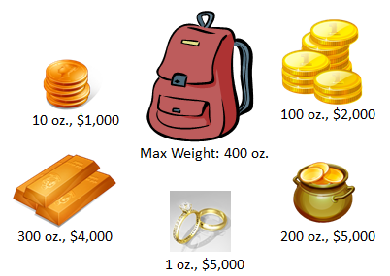

Fractional Knapsack
‹#›

Slide 7
Fractional Knapsack problem
ITEM | PRICE | WEIGHT
X1 | 25 | 18
X2 | 24 | 15
X3 | 15 | 10
Total Item , n = 3
Knapsack Size , m = 20
Three Cases:
Maximum Price
Minimum Weight
Maximum Pi/Wi
X1 | X2 | X3 | Σ WiXi | Σ PiXi
‹#›

Slide 8
Fractional Knapsack problem
ITEM | PRICE | WEIGHT
X1 | 25 | 18
X2 | 24 | 15
X3 | 15 | 10
Total Item , n = 3
Knapsack Size , m = 20
Three Cases:
Maximum Price
Minimum Weight
Maximum Pi/Wi
X1 | X2 | X3 | Σ WiXi | Σ PiXi
Case – 1:
Item 1 : X1 (1)
Profit = 25
m = 20 – 18 = 2
Item 2 : X2 (2/15)
Profit = 24 * (2/15)
= 3.2
m = 2– 2 = 0
Total Profit
= 25 + 3.2
= 28.2
‹#›

Slide 9
Fractional Knapsack problem
ITEM | PRICE | WEIGHT
X1 | 25 | 18
X2 | 24 | 15
X3 | 15 | 10
Total Item , n = 3
Knapsack Size , m = 20
Three Cases:
Maximum Price
Minimum Weight
Maximum Pi/Wi
X1 | X2 | X3 | Σ WiXi | Σ PiXi
1 | 2/15 | 0 | 20 | 28.2
Case – 2:
Item 1 : X3 (1)
Profit = 15
m = 20 – 10 = 10
Item 2 : X2 (10/15)
Profit = 24 * (2/3)
= 16
m = 10– 10 = 0
Total Profit
= 15 + 16
= 31
‹#›

Slide 10
Fractional Knapsack problem
ITEM | PRICE | WEIGHT
X1 | 25 | 18
X2 | 24 | 15
X3 | 15 | 10
Total Item , n = 3
Knapsack Size , m = 20
Three Cases:
Maximum Price
Minimum Weight
Maximum Pi/Wi
X1 | X2 | X3 | Σ WiXi | Σ PiXi
1 | 2/15 | 0 | 20 | 28.2
0 | 10/15 | 1 | 20 | 31
Case – 3: (Pi /Wi)
X1 = P1/W1
= 25/18 = 1.39
X2 = P2/W2
= 24/15 = 1.6
X3 = P3 / W3
= 15 / 10 = 1.5
Item 1 : X2 (1)
Profit = 24
m = 20 – 15 = 5
Item 2 : X3 (5/10)
Profit = 15 * (1/2)
= 7.5
m = 10– 10 = 0
Total Profit
= 24 + 7.5
= 31.5
‹#›

Slide 11
Fractional Knapsack problem
ITEM | PRICE | WEIGHT
X1 | 25 | 18
X2 | 24 | 15
X3 | 15 | 10
Total Item , n = 3
Knapsack Size , m = 20
Three Cases:
Maximum Price
Minimum Weight
Maximum Pi/Wi
X1 | X2 | X3 | Σ WiXi | Σ PiXi
1 | 2/15 | 0 | 20 | 28.2
0 | 10/15 | 1 | 20 | 31
0 | 1 | 1/2 | 20 | 31.5
‹#›

Slide 12
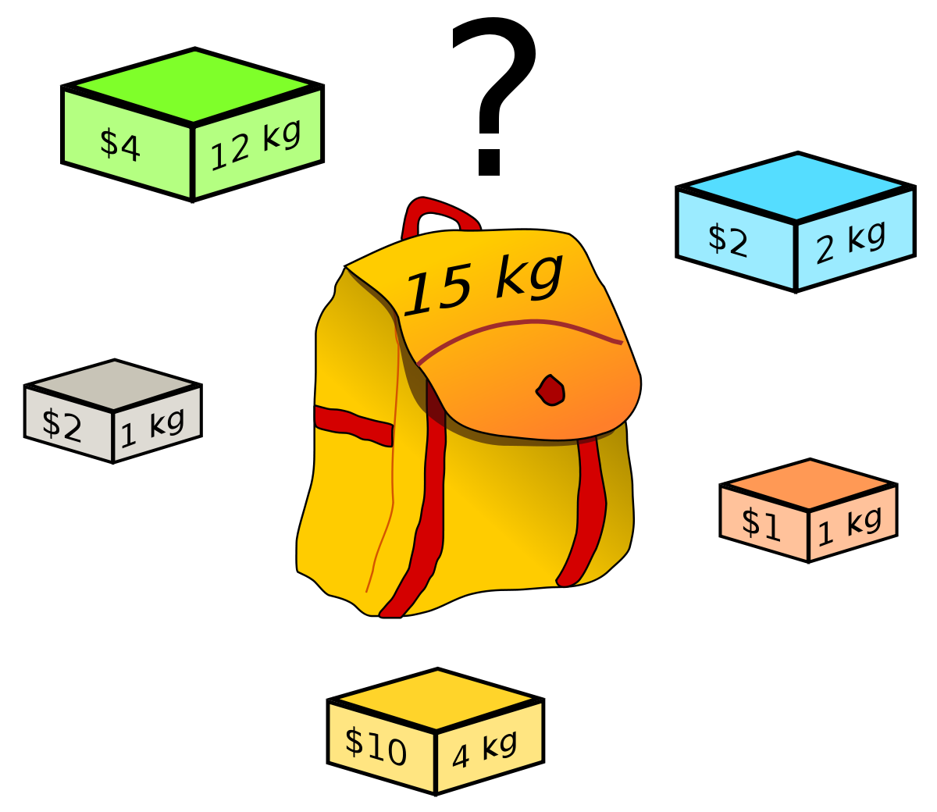
0/1 Knapsack Problem
‹#›

Slide 13
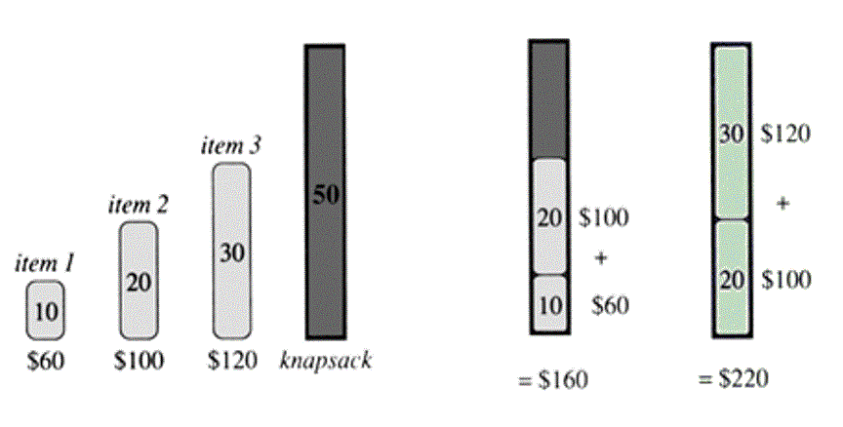
0/1 Knapsack
m=50
X2
P =100
X1
P =60
x1 = p1/w1
= 60/10
= 6
x2 = p2/w2
= 100/20
= 5
x3 = p3/w3
= 120/30
= 4
Profit = 60 + 100
= 160
‹#›

Slide 14
Drawbacks of Greedy Methods
Does not always find the optimal solution for some problems.
‹#›

Slide 15
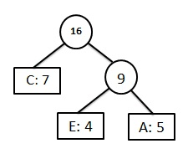
Greedy Algorithms
Part - 4 : Huffman Coding
Notes:
‹#›

Slide 16
Huffman Codes
Widely used technique for data compression
Assume the data to be a sequence of characters
Looking for an effective way of storing the data
Binary character code
Uniquely represents a character by a binary string
‹#›

Slide 17
Two Ways to Compress data
1. Fixed-Length Codewords
2. Variable-Length Codewords
‹#›

Slide 18
Example
Suppose you have to compress a data file containing 100,000 characters
The data file only has 6 characters (a, b, c, d, e, f)
Characters | a | b | c | d | e | f
Frequency (thousands) | 45 | 13 | 12 | 16 | 9 | 5
‹#›

Slide 19
1. Fixed-Length Codes
Data file containing 100,000 characters
3 bits needed
a = 000, b = 001, c = 010, d = 011, e = 100, f = 101
Requires: 100,000 * 3 = 300,000 bits
Characters | a | b | c | d | e | f
Frequency (thousands) | 45 | 13 | 12 | 16 | 9 | 5
‹#›

Slide 20
2. Huffman Codes
Idea:
Variable Length Codes
Use the frequencies of occurrence of characters to build a optimal way of representing each character
‹#›

Slide 21

Constructing a Huffman Code
Idea:
1. Arranging the characters in order of their frequencies Ascending
2. Add Two minimum frequencies and place them to the right position
‹#›

Slide 22

Example
c: 12
b: 13
14
d: 16
a: 45
0
1
f: 5
e: 9
14
d: 16
25
a: 45
25
30
a: 45
0
1
0
1
0
1
0
1
f: 5
e: 9
c: 12
b: 13
c: 12
b: 13
14
d: 16
0
1
f: 5
e: 9
55
0
100
1
a: 45
0
1
a: 45
55
25
30
0
1
0
1
0
1
25
30
c: 12
b: 13
14
d: 16
0
1
0
1
0
1
c: 12
b: 13
14
d: 16
f: 5
e: 9
0
1
‹#›
f: 5
e: 9

Slide 23
Codewords
100
Character | Codeword
a
b
c
d
e
f
a: 45
55
25
30
c: 12
b: 13
14
d: 16
f: 5
e: 9
‹#›

Slide 24
Codewords
0
100
1
Character | Codeword
a
b
c
d
e
f
a: 45
55
0
1
25
30
0
1
0
1
c: 12
b: 13
14
d: 16
0
1
f: 5
e: 9
‹#›

Slide 25
Codewords
0
100
1
Character | Codeword
a | 0
b | 101
c | 100
d | 111
e | 1101
f | 1100
a: 45
55
0
1
25
30
0
1
0
1
c: 12
b: 13
14
d: 16
0
1
f: 5
e: 9
‹#›

Slide 26
Variable-Length Codes
Data file containing 100,000 characters
((45 * 1) + (13 * 3) + (12 * 3) + (16 * 3) + (9 * 4) + (5 * 4)) X 1,000
= 224,000 bits
Assign short codewords to frequent characters and long codewords to infrequent characters
Characters | a | b | c | d | e | f
Frequency (thousands) | 45 | 13 | 12 | 16 | 9 | 5
Variable length Codewords | 0 | 101 | 100 | 111 | 1101 | 1100
‹#›

Slide 27
Comparison Ration
Characters | a | b | c | d | e | f
Frequency (thousands) | 45 | 13 | 12 | 16 | 9 | 5
Fixed Length Codewords | 000 | 001 | 010 | 011 | 100 | 101
Variable length Codewords | 0 | 101 | 100 | 111 | 1101 | 1100
300000 – 224000
X 100
300000
= 25.33%
Saves 20% to 90% cost.
‹#›

Slide 28
Huffman Code: Algorithm
Alg.: HUFFMAN(C)
n ← ⎜C ⎜
Q ← C
for i ← 1 to n – 1
do allocate a new node z
left[z] ← x ← EXTRACT-MIN(Q)
right[z] ← y ← EXTRACT-MIN(Q)
f[z] ← f[x] + f[y]
INSERT (Q, z)
return EXTRACT-MIN(Q)
Running time: O(nlgn)
O(n)
O(nlgn)
‹#›

Slide 29
Encoding and Decoding
0
100
1
Character | Codeword
a | 0
b | 101
c | 100
d | 111
e | 1101
f | 1100
a: 45
55
0
1
25
30
0
1
0
1
c: 12
b: 13
14
d: 16
0
1
f: 5
e: 9
Exercise:
1. Encode : abcde 01011001111101
2. Decode: 101100011111011100 bcadef
‹#›

Slide 30
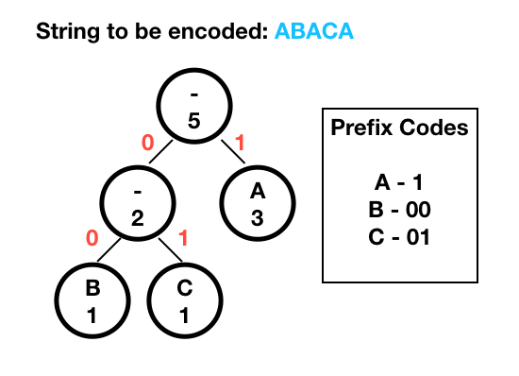
A = 3 , B = 1, C = 1
Notes:
‹#›

Slide 31

Thank you!
‹#›

